Slide 1



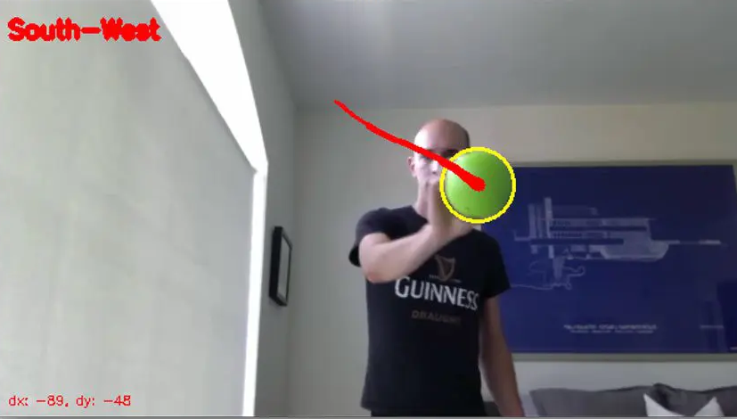
Session 10 :
Introduction to Object Tracking

Slide 2

Introduction
Object Tracking involves locating and following a specific object over time in a video stream.
It is crucial in robotics, augmented reality, and sports analysis.

Slide 3
Learning Outcome
Learn how to track objects in real-time using color-based detection techniques.
Understand object localization using bounding boxes and centroids.

Slide 4
Python Programming Task : Object Tracking
Write a Python script using OpenCV to:
- Capture video input.
- Detect a specific color range.
- Track and visualize a moving object.

Slide 5
Why It Matters
Object tracking supports:
- Autonomous navigation (e.g., self-driving cars)
- Augmented reality (AR) overlays
- Sports analytics for player movement tracking

Slide 6
Real-World Example
1. Tracking a player during a football match using their jersey color.
2. Following a red ball with a mobile robot for obstacle avoidance or path planning.

Slide 7
Understanding Color-Based Tracking
Use HSV color space to isolate bright or distinct colors.
Color-based tracking is robust against object deformation and orientation changes.

Slide 8
Implementing Color Detection
Use OpenCV's cv2.inRange to define HSV color bounds.
Generate a binary mask to isolate the object in each frame.

Slide 9
Tracking with Contours
Use contour detection to:
- Identify object boundaries
- Calculate centroid or draw bounding box for tracking
Helps in position tracking over time.

Slide 10
Visualizing Tracked Objects
Draw bounding shapes using:
- cv2.circle for centroid visualization
- cv2.rectangle for object boundary
Enables clear representation of tracked object.

Slide 11
Handling Lighting Variations
To improve reliability:
- Adjust HSV ranges dynamically
- Use morphological operations (e.g., erosion, dilation) to reduce noise and enhance detection.

Slide 12
Python Code:
Object Tracking – Overview
Project Title: Color-Based Object Tracking with ROI Selection
Objective:
- Track objects in video based on a user-selected Region of Interest (ROI)
- Utilize color-based tracking through histogram backprojection

Slide 13
Step 1 – Initialization and ROI Selection
Video Initialization:
- Open video stream using cv2.VideoCapture
- Read first frame for initial user input
ROI Selection:
- Use cv2.selectROI for manual selection of the target object
- Extract HSV histogram using cv2.calcHist

Slide 14
Step 2 – Backprojection and Masking
Histogram Back projection:
- Convert each frame to HSV color space using cv2.cvtColor
- Calculate backprojection using the stored ROI histogram
Thresholding:
- Apply binary thresholding with cv2.threshold to isolate target regions

Slide 15
Step 3 – Noise Filtering and Bounding Box
Noise Reduction:
- Use cv2.morphologyEx with a 5x5 kernel for mask cleanup
Contour Tracking:
- Detect contours using cv2.findContours
- Draw bounding box using cv2.rectangle if contour area > 500

Slide 16
Step 4 – Real-Time Execution and Error Handling
Real-Time Loop:
- Display frame with tracked object in a continuous loop
- Exit loop cleanly on pressing 'q'
Error Checking:
- Validate video loading and frame reading
- Ensure ROI is selected before proceeding

Slide 17

Python Script on Object Tracking
PART 1
import cv2
import numpy as np
def nothing(x):
pass
image = cv2.imread('image.jpg')
if image is None:
raise ValueError("Image not found!")
rows, cols = image.shape[:2]

Slide 18
Python Script on Object Tracking
PART 2
import cv2
import numpy as np
cap = cv2.VideoCapture('video.mp4')
if not cap.isOpened():
raise ValueError("Video not found!")
ret, frame = cap.read()
if not ret:
raise ValueError("Cannot read video!")

Slide 19
Python Script on Object Tracking
PART 3
roi_box = cv2.selectROI("Select ROI", frame, fromCenter=False)
roi = frame[int(roi_box[1]):int(roi_box[1]+roi_box[3]), int(roi_box[0]):int(roi_box[0]+roi_box[2])]
hsv_roi = cv2.cvtColor(roi, cv2.COLOR_BGR2HSV)
roi_hist = cv2.calcHist([hsv_roi], [0, 1], None, [180, 256], [0, 180, 0, 256])
cv2.normalize(roi_hist, roi_hist, 0, 255, cv2.NORM_MINMAX)

Slide 20
Python Script on Object Tracking
PART 4
while True:
ret, frame = cap.read()
if not ret:
break
hsv = cv2.cvtColor(frame, cv2.COLOR_BGR2HSV)
dst = cv2.calcBackProject([hsv], [0, 1], roi_hist, [0, 180, 0, 256], 1)
_, mask = cv2.threshold(dst, 50, 255, cv2.THRESH_BINARY)
mask = cv2.morphologyEx(mask, cv2.MORPH_OPEN, np.ones((5,5), np.uint8))
contours, _ = cv2.findContours(mask, cv2.RETR_EXTERNAL, cv2.CHAIN_APPROX_SIMPLE)

Slide 21
Python Script on Object Tracking
PART 5
if contours:
c = max(contours, key=cv2.contourArea)
if cv2.contourArea(c) > 500:
x, y, w, h = cv2.boundingRect(c)
cv2.rectangle(frame, (x, y), (x+w, y+h), (0, 255, 0), 2)
cv2.imshow('Object Tracking', frame)
if cv2.waitKey(1) & 0xFF == ord('q'):
break
cap.release()
cv2.destroyAllWindows()

Slide 22
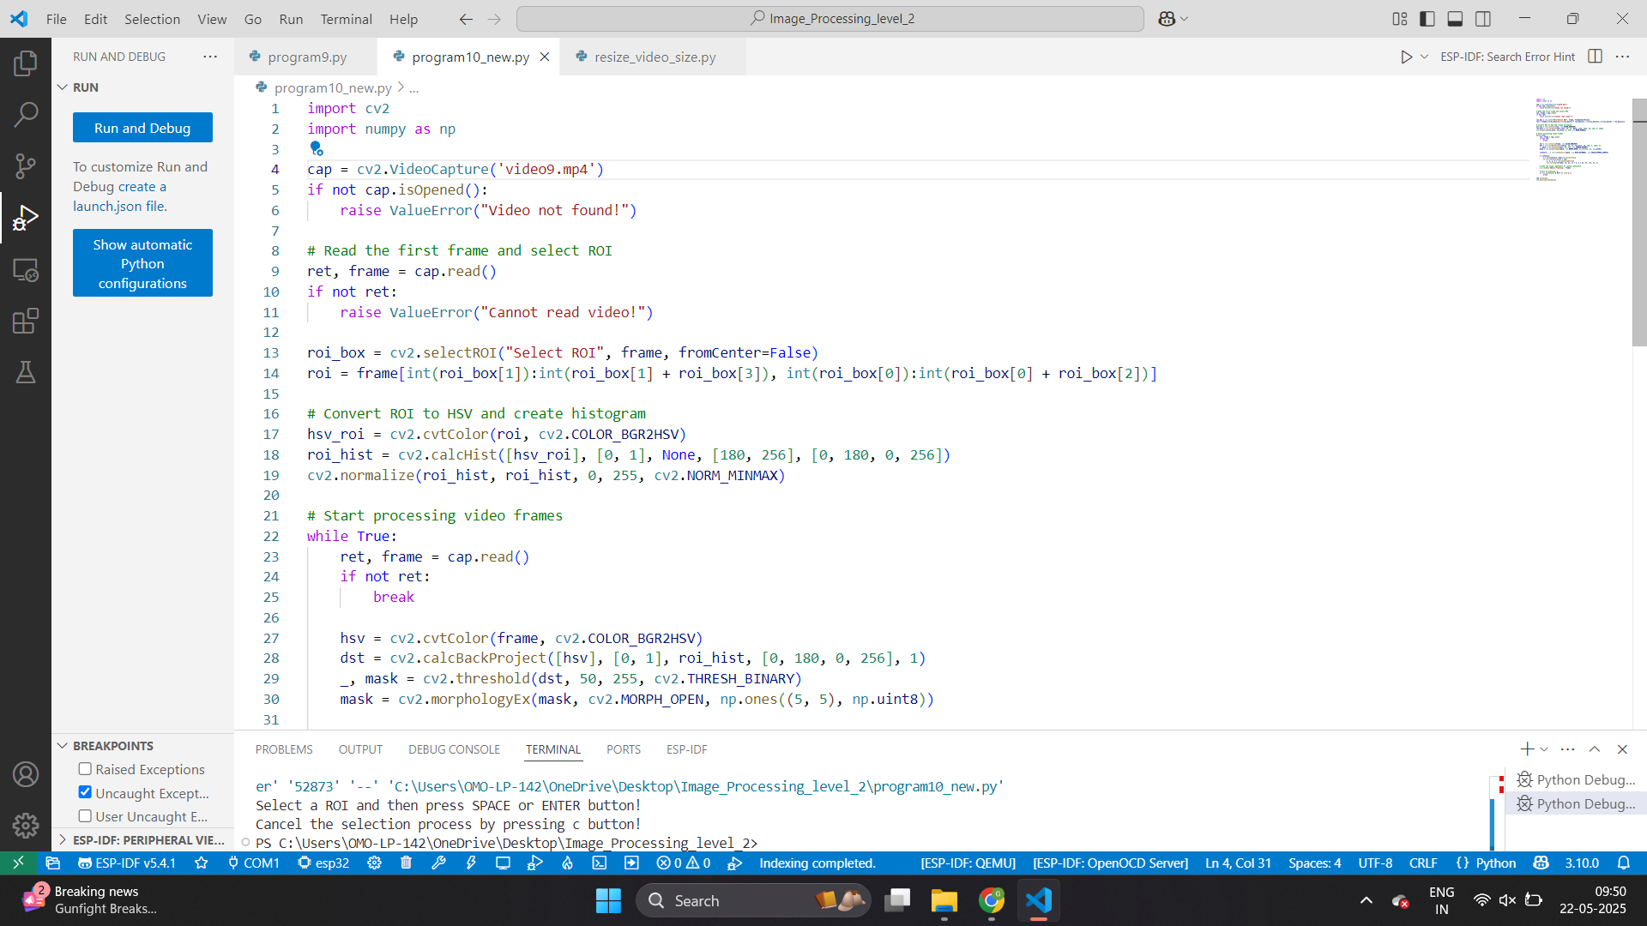

Slide 23
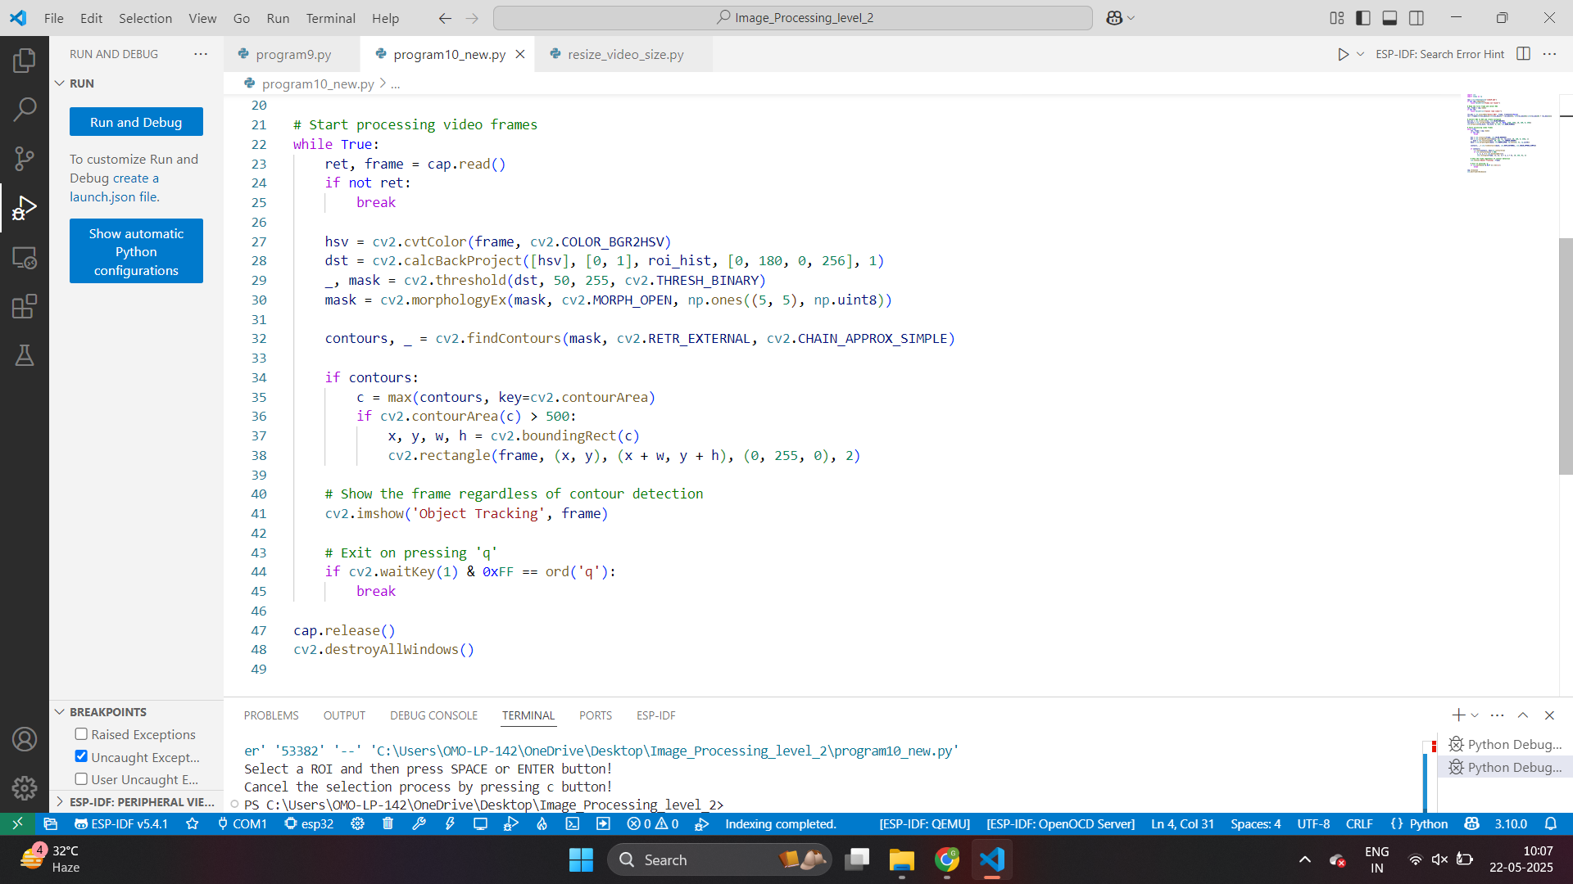

Slide 24
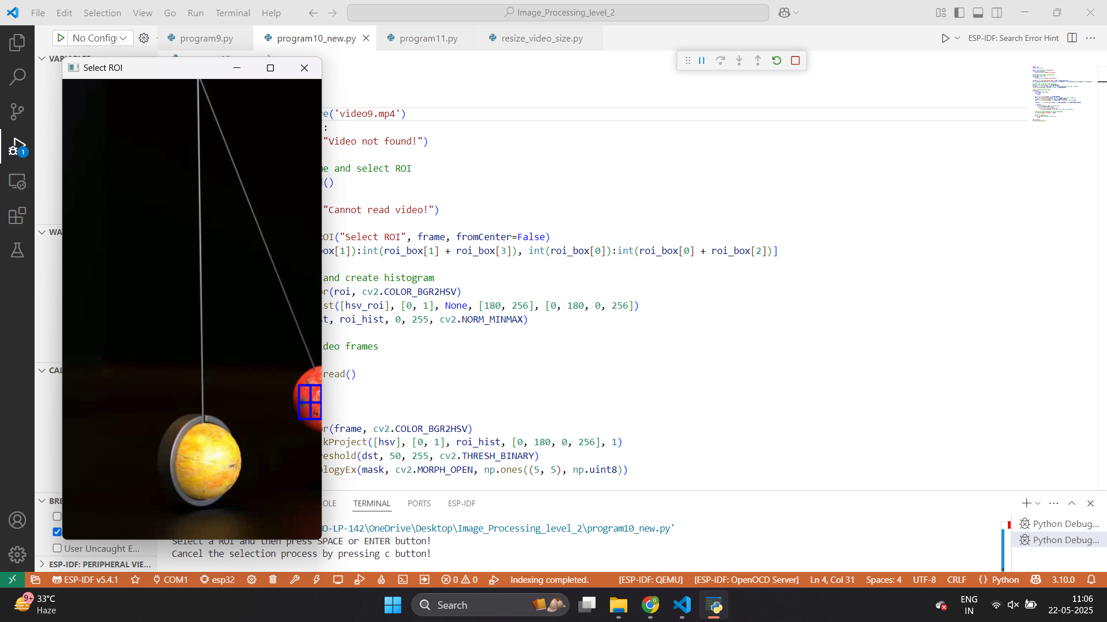

Slide 25
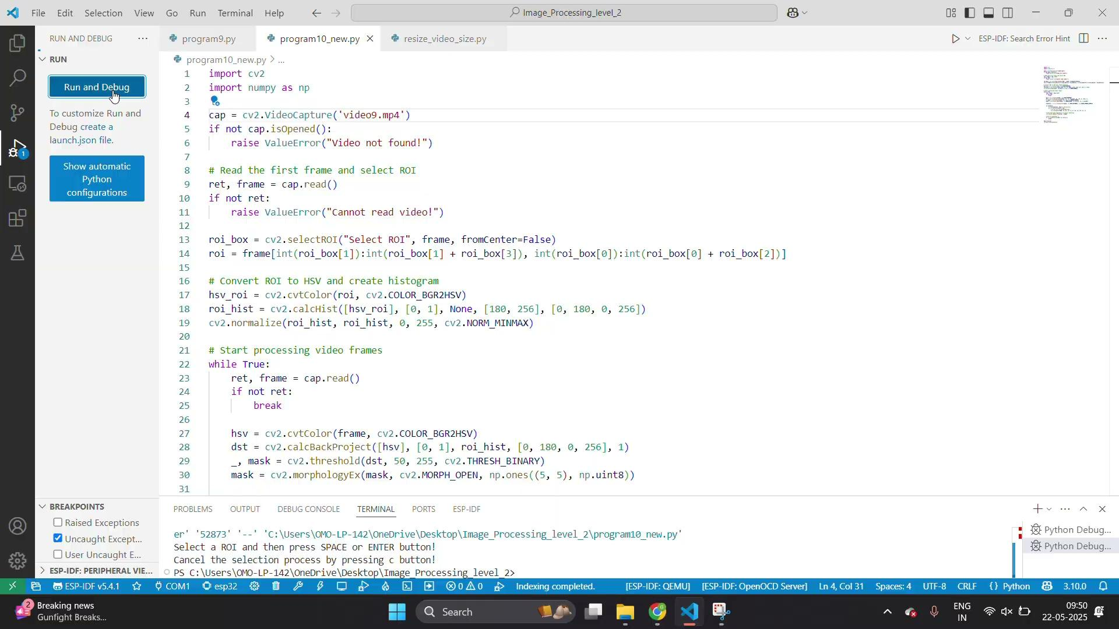

Slide 26
Exercise
1. What is the primary goal of object tracking in image processing?
A) Identify object color
B) Count number of pixels
C) Locate and follow objects over time
D) Convert image to grayscale
Answer: C
2. Which color space is commonly used for color-based object tracking?
A) RGB
B) CMYK
C) HSV
D) YUV
Answer: C

Slide 27
Exercise
3. What OpenCV function is used to capture video from a webcam or file?
A) cv2.VideoWriter()
B) cv2.imshow()
C) cv2.VideoCapture()
D) cv2.VideoPlay()
Answer: C
4. What OpenCV method is used to allow the user to manually select the tracking region?
A) cv2.selectObject()
B) cv2.selectROI()
C) cv2.markROI()
D) cv2.chooseRegion()
Answer: B

Slide 28
Exercise
5. What is the purpose of histogram backprojection in tracking?
A) To convert an image to binary
B) To detect edges in the image
C) To locate regions matching the ROI color distribution
D) To calculate pixel brightness
Answer: C
6. Which function is used to filter noise in the tracking mask?
A) cv2.filter()
B) cv2.erode()
C) cv2.GaussianBlur()
D) cv2.morphologyEx()
Answer: D

Slide 29
Exercise
7. What condition is used before drawing a bounding box around a contour?
A) If the contour is a square
B) If contour area is greater than 500
C) If image is binary
D) If the user clicks the mouse
Answer: B
8. Which function is used to draw a bounding box around a detected object?
A) cv2.drawBox()
B) cv2.circle()
C) cv2.rectangle()
D) cv2.boundingBox()
Answer: C

Slide 30
Exercise
9. What key is typically used to exit the real-time object tracking loop?
A) Enter
B) q
C) Esc
D) Space
Answer: B
10. Why is object tracking useful in real-world applications?
A) To reduce file size
B) For histogram equalization
C) For augmented reality and robotics navigation
D) For image segmentation
Answer: C

